Slide 1
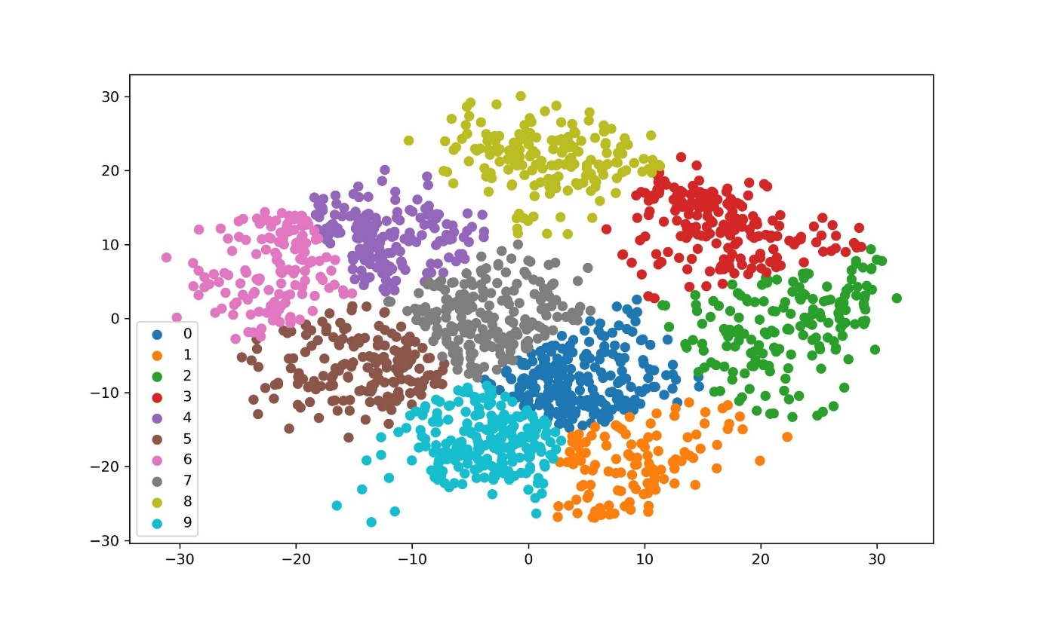
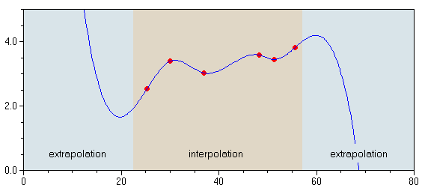
Lesson 3: Machine Learning
How can we get machines to ‘understand’, and therefore speak usefully about data?

Slide 2
Schedule
Principles of Regression, Classification, Noise, Overfitting and Cross-Validation: 10:00-11:00
Break: 11:00-11:30
Classification and Regression with Decision Trees and Random Forests: 11:30-12:00
Time for Exercises/Questions (Decision Trees and Random Forests): 12:00-12:30
Break: 12:30-13:30
Support Vector Machines for Classification: 13:30-14:00
Time for Exercises/Questions (Support Vector Machines) 14:00-14:30
Break: 14:30-15:00
Time for Exercises/Questions (Catch-up) OR Bonus Content (Regularisation): 15:00-16:00

Slide 3
Regression
If we have some input data points and some ‘answers’ to go with them (training data), what will the answers be for future inputs?
Linear regression is for finding the line of best fit
The straight line which best predicts answers – hopefully including future ones!
Can be extended – we could also find a curve of best fit if we use a more complicated equation than a straight line

Slide 4
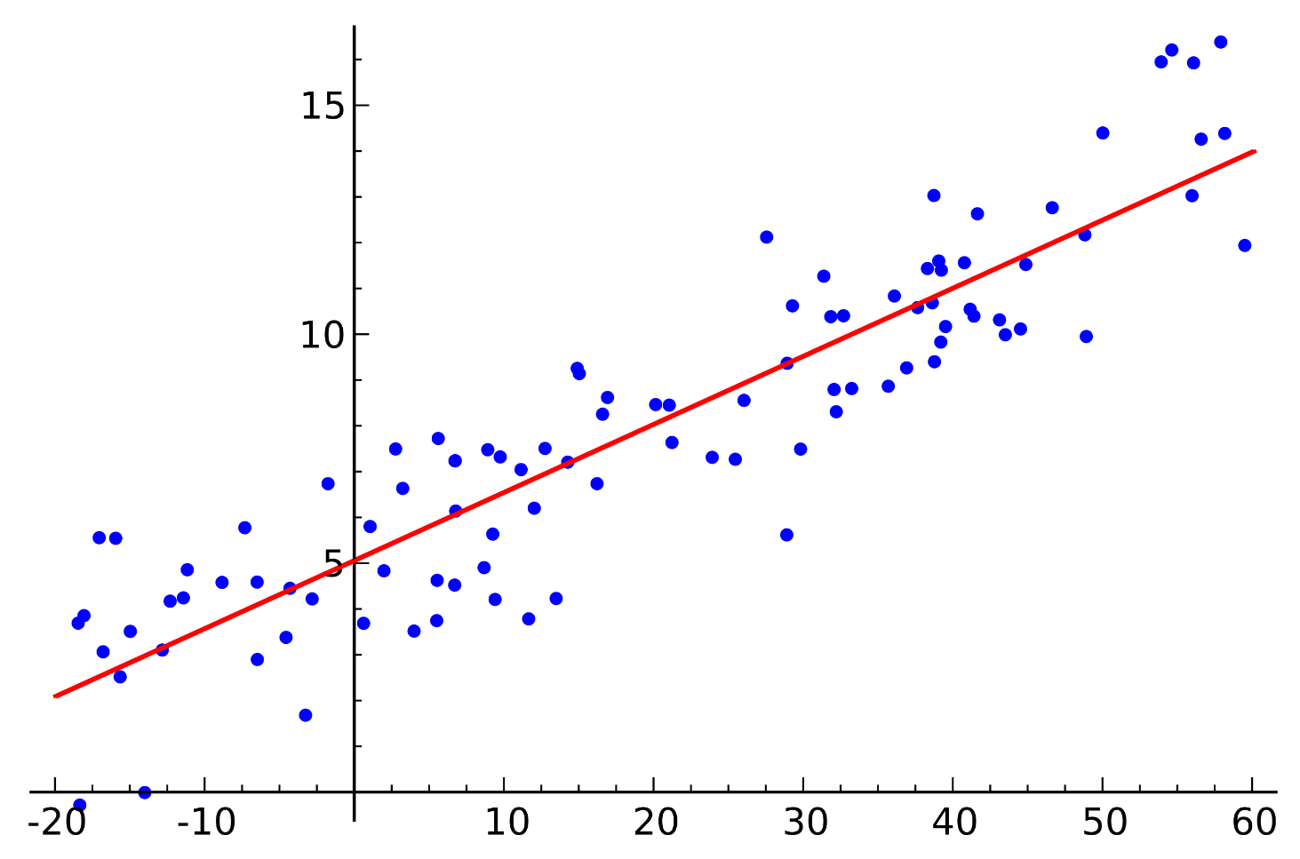

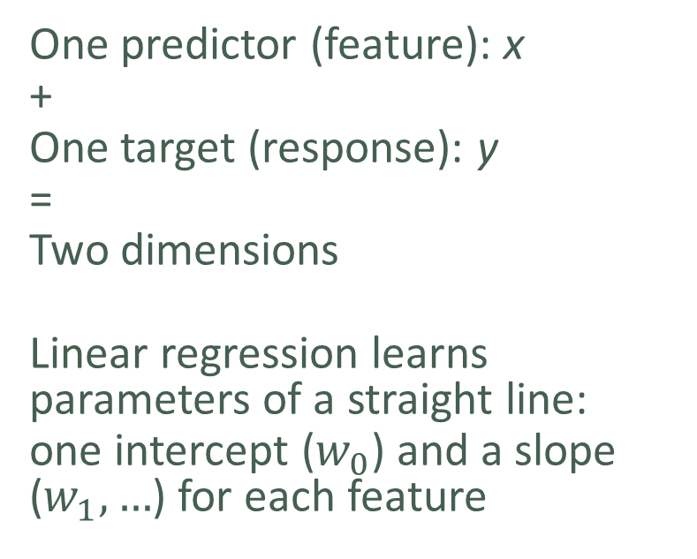

Linear Regression
$$y=w_{0}+w_{1}x+ε$$
$(ε$ is noise – cannot be learned)
One predictor (feature): x
+
One target (response): y
=
Two dimensions
Linear regression learns parameters of a straight line:
one intercept ($w_{0}$) and a slope ($w_{1}, …$) for each feature

Slide 5
Classification
If we have some input data and some ‘answers’ – and this time the answers are discrete (as opposed to continuous) – what will the answers be for future inputs?
E.g.: which manufacturer made the car in this image?
Logistic regression is commonly used to predict probabilities which we can use to classify (binary classification but can be extended)
Other GRC courses will/have covered linear and logistic regression. However, examples are included in the worksheets for your interest

Slide 6
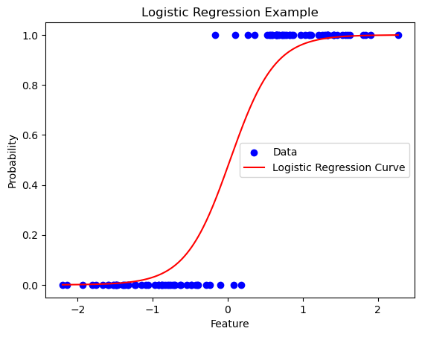

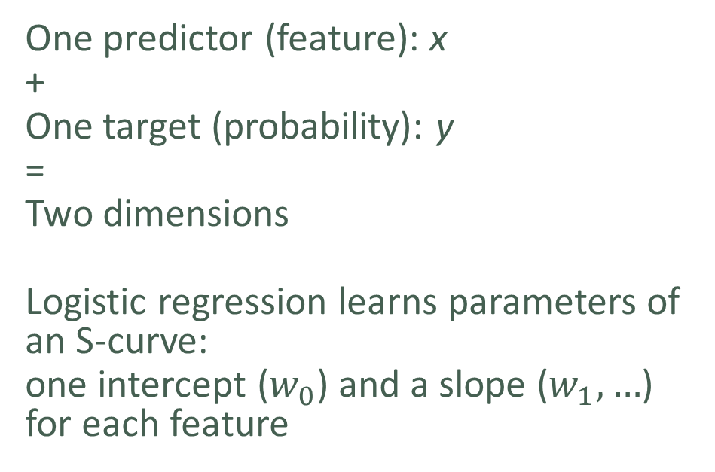
Logistic Regression
$$\log\left(\frac{y}{1−y}\right)=w_{0}+w_{1}x$$
aka
$$y={σ(w}_{0}+w_{1}x) : σ\left(x\right)≡\frac{1}{1+e^{−x}}$$
One predictor (feature): x
+
One target (probability): y
=
Two dimensions
Logistic regression learns parameters of an S-curve:
one intercept ($w_{0}$) and a slope ($w_{1}, …$) for each feature

Slide 7
Noise
Unless your problem is made-up, you will never be able to predict unseen data perfectly
Noise is the random variation in the data which stops your predictions from being perfect
Noise comes in two flavours:
The noise which you could get rid of if your model was better, called epistemic noise
The noise which no model of the data you have could capture, called aleatoric noise
‘Episteme’ – Ancient Greek for ‘knowledge’
Chaos theory in a nutshell: there isn’t enough data to make a perfect model

Slide 8
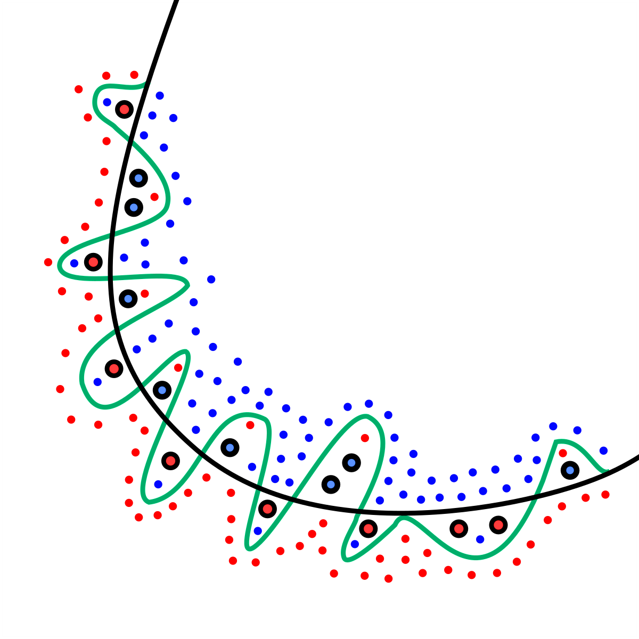
Overfitting
True class boundary
Noise
Overfitting is when a model gets so good at predicting noise in the training data that it can no longer accurately predict into the future
This requires powerful models or very poor data
Linear/logistic regression only overfit on very poor (or very little) data
The models we are about to look at can get overfitted to noise in any data
Predicted class boundary
Noise
Class 2
Class 1

Slide 9
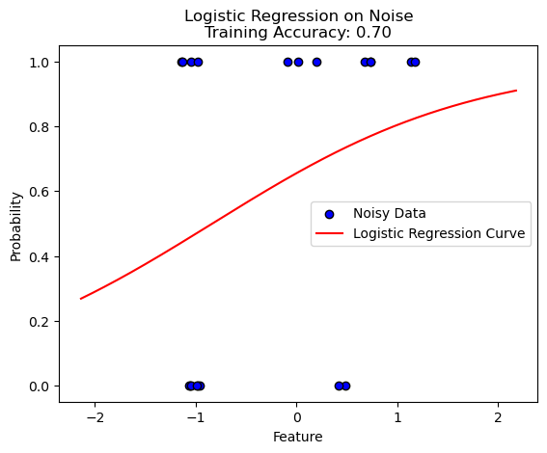
Overfitting

Slide 10
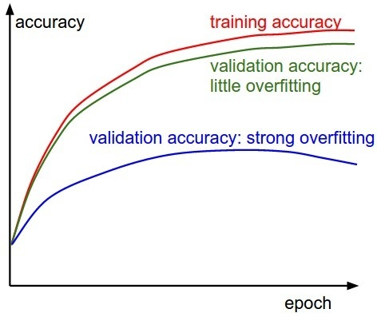
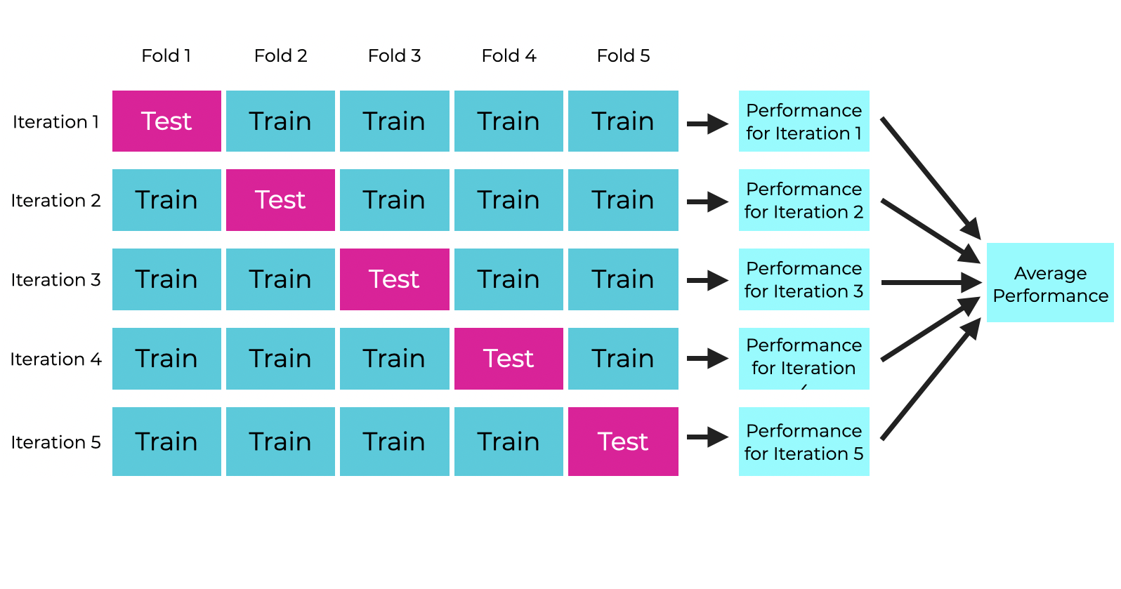
Cross-validation
To measure overfitting, we often keep roughly (not strictly) 20% of the training data in reserve (the validation data)
As we make the model more complex, we regularly check how well it does on the validation data – when it starts getting worse, we know it is beginning to overfit
To prevent bias from which 20% we used as validation data, we slice the data into 5 chunks, and train 5 times, using each chunk once (cross-validation)
complexity

Slide 11
Decision trees
We can draw a series of if/then statements which can let us decide answers based on questions about our data:
If your temperature is high, you are ill
If your blood pressure and heart rate are high, and you are not exercising, you are unhealthy
Answers may be categorical (healthy, unhealthy, ill) or continuous (size of life insurance premium)
But we want the machine to learn these things on its own, rather than need us tell it

Slide 12
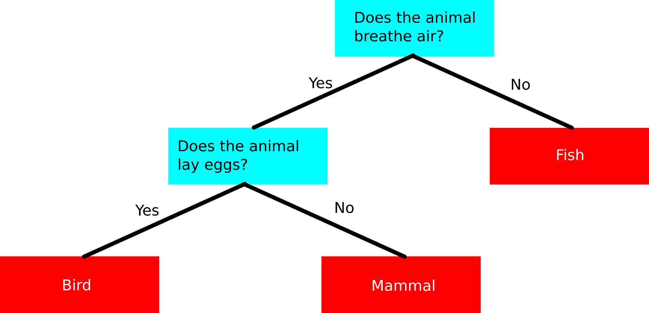
Decision trees
Node
Leaf

Slide 13
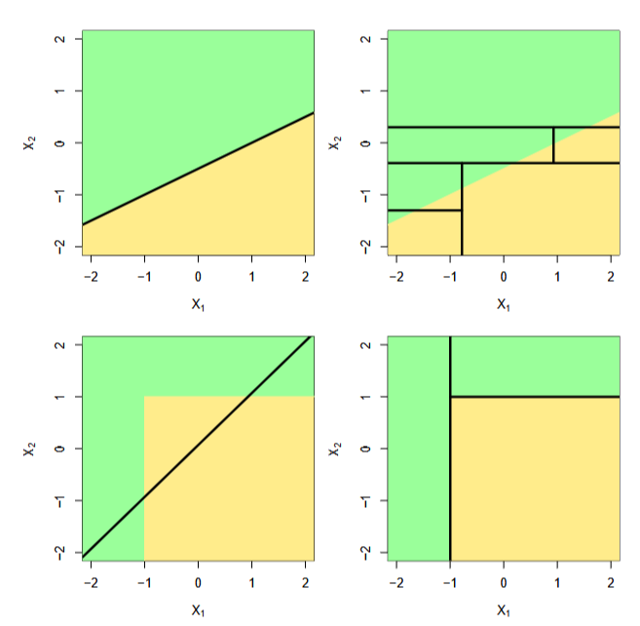
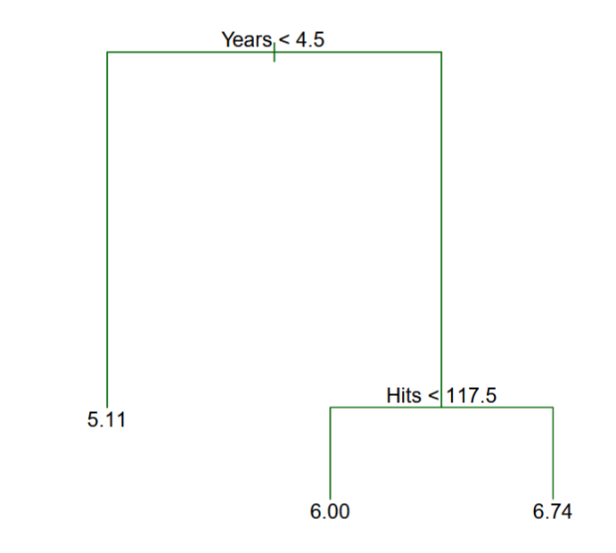
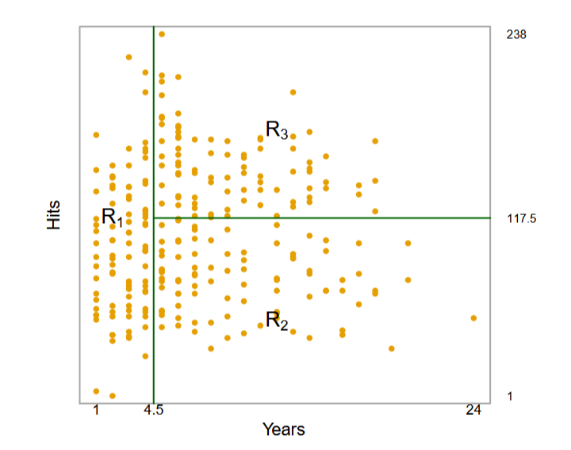
Decision trees
Baseball players’ salary (x $1000)
Baseball players’ data with the learned decision boundaries for salary
Decision trees can learn to predict data in which the relationship is not linear. In this example, the relationship between predictor and response is non-linear. Decision trees can be used to learn non-linear decision boundaries for classification as well.

Slide 14
Tree training
At each step (epoch) tree ‘grows’ a layer using the training data
Each layer splits the tree (and the data) into nodes
Each node represents a decision about the data in it

Slide 15
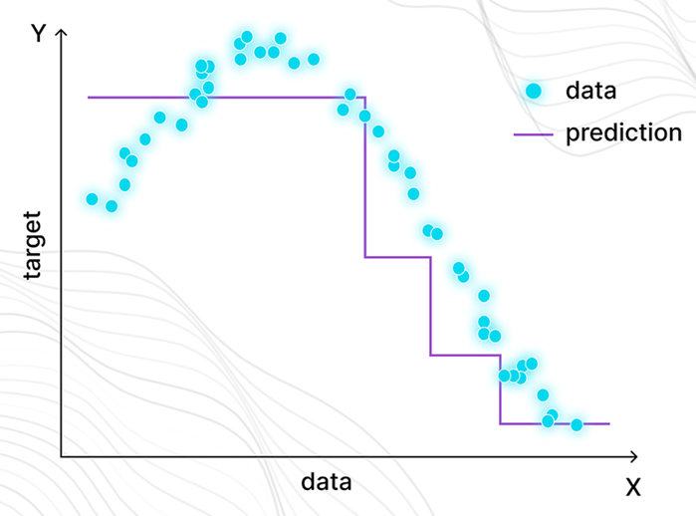
Tree training
For regression:
The samples are split so that their mean is as close to the true value as possible (see right)
Each horizontal line represents a node

Slide 16
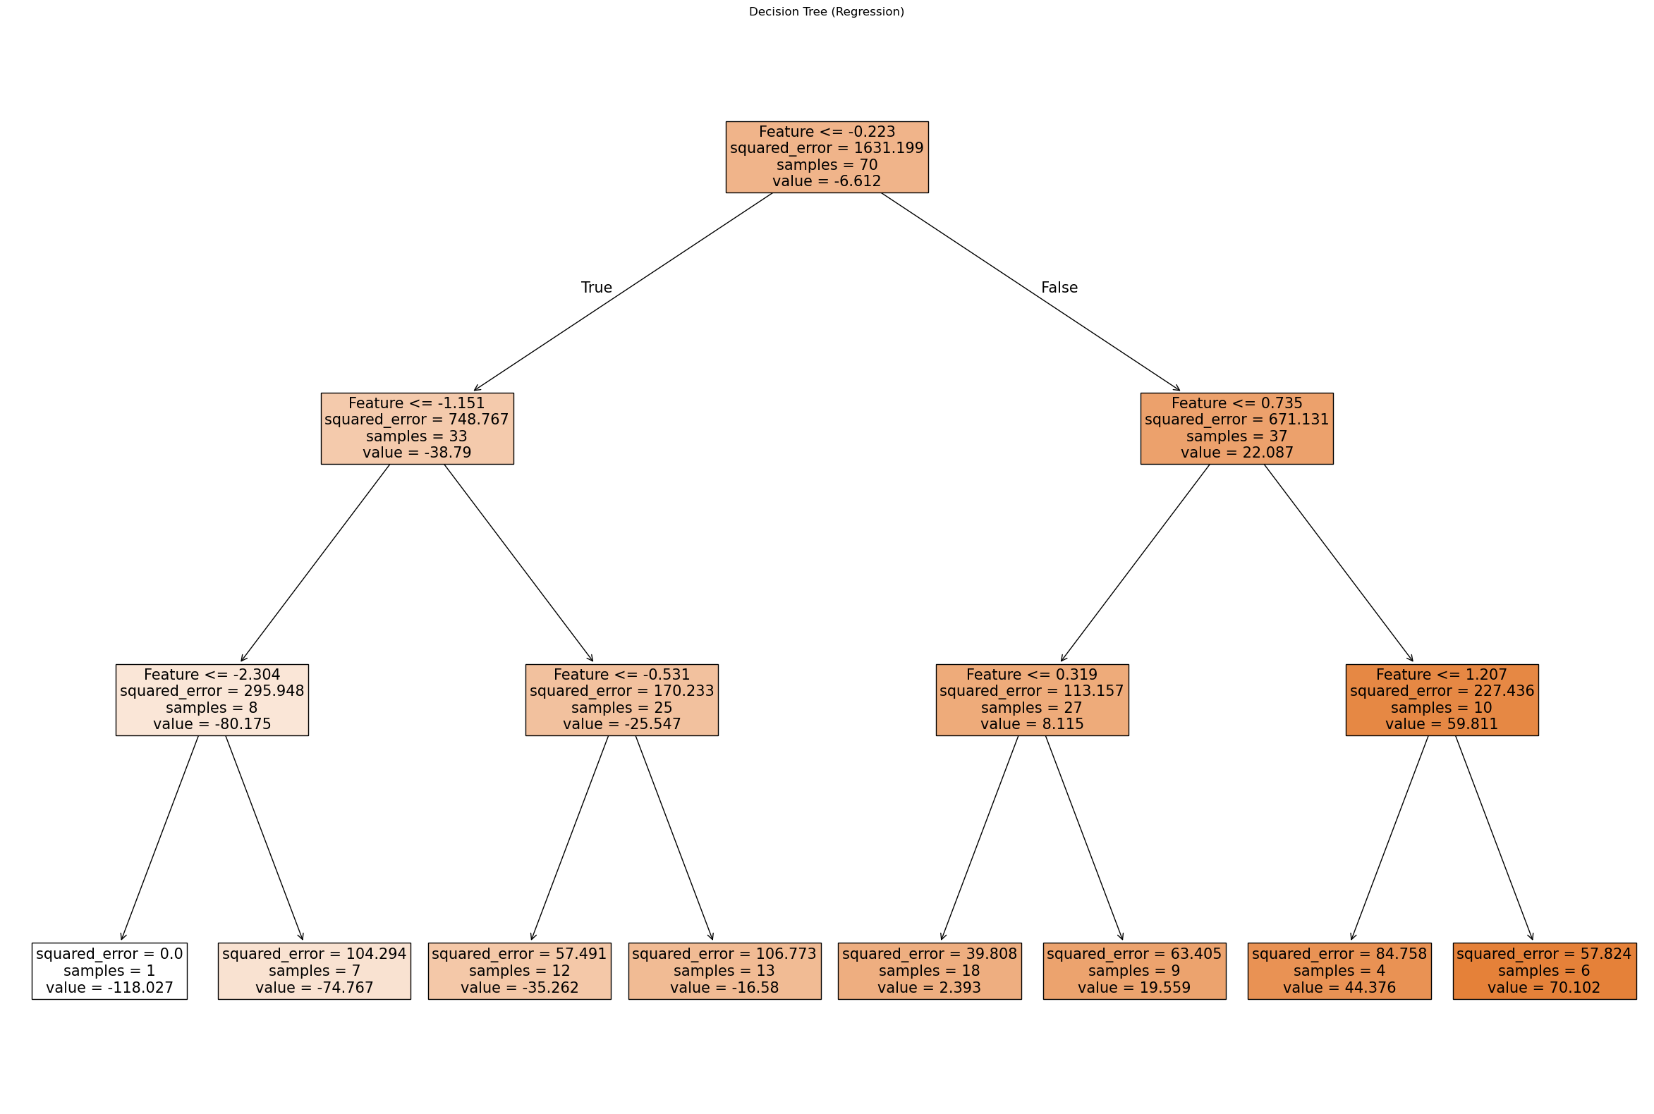
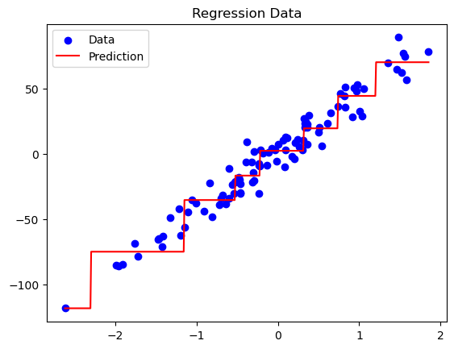
Tree training

Slide 17
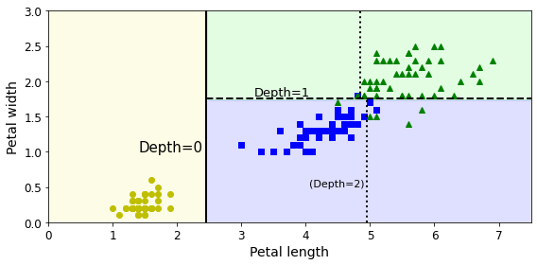
Tree training
For classification:
At each layer, the tree splits the training samples into nodes by choosing a feature (column) and a threshold value so that the samples in each node will be as well-divided as possible (see right)

Slide 18
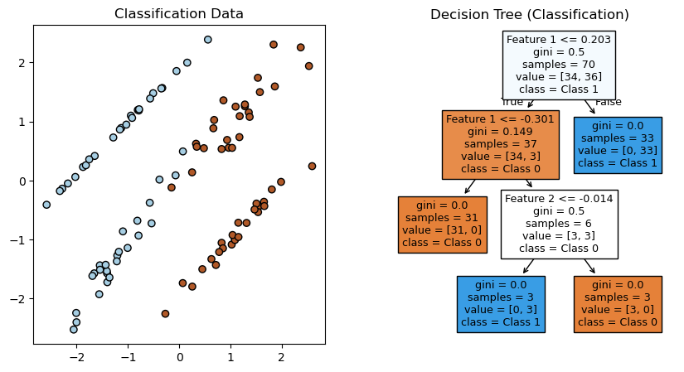
Tree training

Slide 19
(Random) Forests and Ensembles
A forest is a collection of (different) trees.
Trees are different because they are trained on different subsets of the data
This could be datapoints (rows) or features (columns) – “bootstrapping”
We take the answer which the most trees agree on if we are classifying, or the average if we are doing regression (bagging)
This ensemble (assembly, group) of models can be very accurate after a while
Just like asking a good group of friends!
The ensemble concept is applicable to most types of ML models

Slide 20
Random Forests and Ensembles
Advantages:
Interpretability: Decision trees are easy to interpret and visualize.
Handles Non-Linearity: Random forests can handle non-linear relationships effectively by combining multiple decision trees.
Feature Importance: Random forests provide insights into feature importance, which is useful for understanding the model.
Robust to Noise: Random forests are less sensitive to noise and overfitting compared to individual decision trees.
Scalability: They scale well to large datasets.
Disadvantages
Overfitting in Decision Trees: Individual decision trees are prone to overfitting, though this is mitigated by random forests.
Less Effective for High-Dimensional Data: Random forests may struggle with very high-dimensional datasets.
Computationally Intensive: Training random forests can be computationally expensive, especially with many trees.
No Clear Decision Boundary: They do not provide a clear mathematical decision boundary.

Slide 21
Lesson 3 – Exercise 1
Let’s do an exercise on the Iris dataset!
The code is written for you, run it and see how it does.
Then, change the parameters. Can you get better predictions? How?
Repeat for the California Housing dataset!

Slide 22
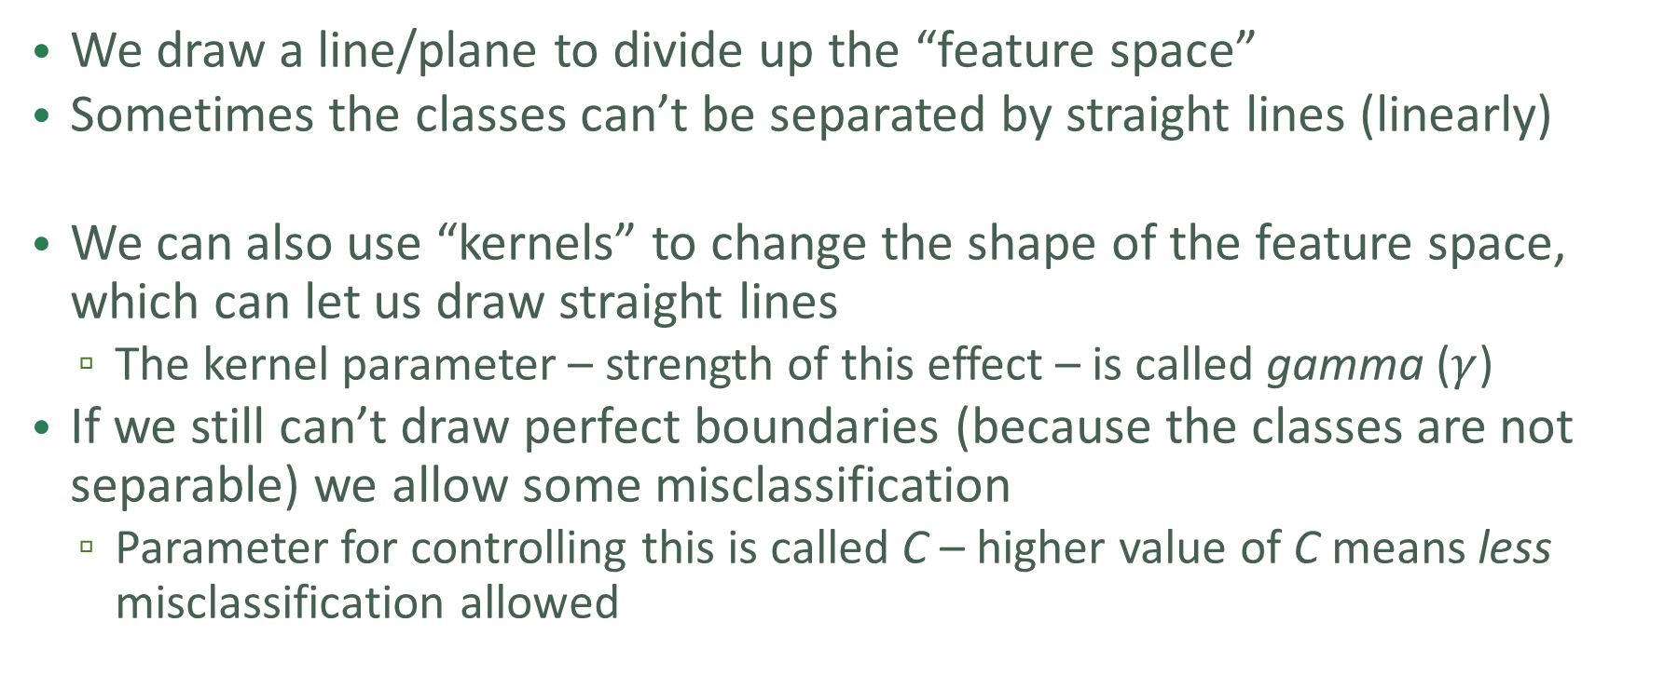
Support Vector Machines
We draw a line/plane to divide up the “feature space”
Sometimes the classes can’t be separated by straight lines (linearly)
We can also use “kernels” to change the shape of the feature space, which can let us draw straight lines
The kernel parameter – strength of this effect – is called gamma ($γ$)
If we still can’t draw perfect boundaries (because the classes are not separable) we allow some misclassification
Parameter for controlling this is called C – higher value of C means less misclassification allowed

Slide 23
SVM Training
The algorithm simply calculates all possible support vectors (ways of separating the data)
It chooses the one with the widest margin of separation
As we discussed, the C parameter controls the “hardness” of this margin
Soft margins are sometimes necessary to avoid overfitting

Slide 24
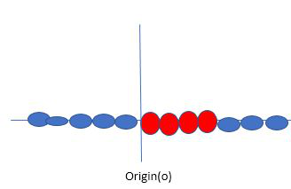
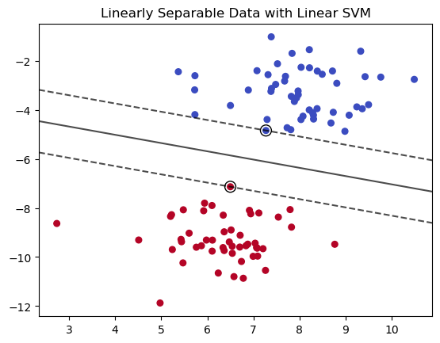
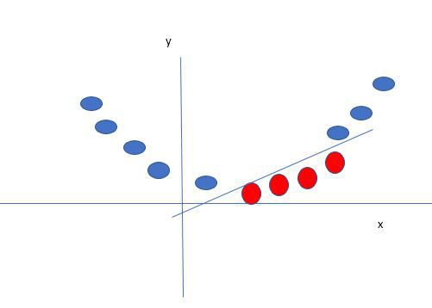
Support Vector Machines
Kernel
Support vector

Slide 25
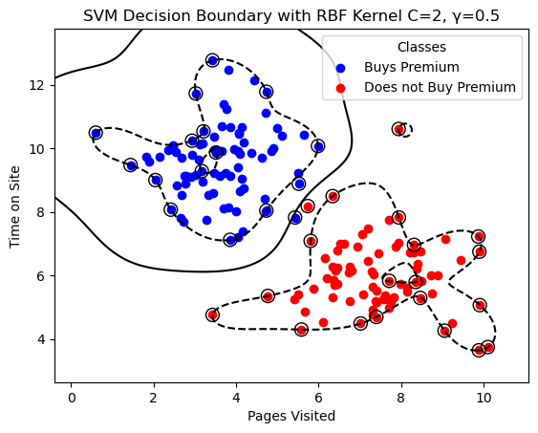
Support Vector Machines

Slide 26
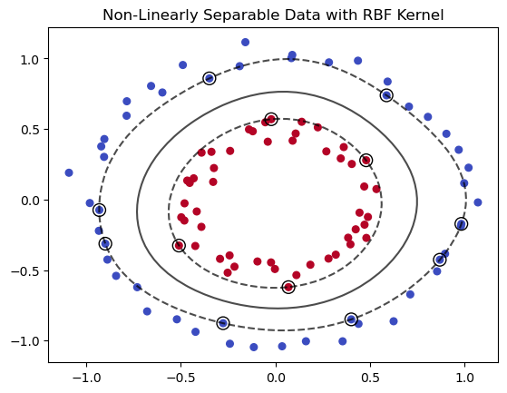
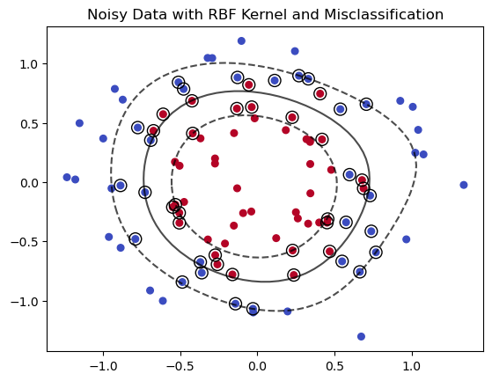
Support Vector Machines

Slide 27
Support Vector Machines
Advantages
Effective in High Dimensions: SVMs perform well in high-dimensional spaces and with sparse data.
Robust Decision Boundary: SVMs aim to find the optimal hyperplane that maximizes the margin, making them robust to overfitting in certain cases.
Kernel Trick: The use of kernels allows SVMs to model complex, non-linear relationships effectively.
Works Well with Small Datasets: SVMs are effective for smaller datasets where the number of features is greater than the number of samples.
Disadvantages
Difficult to Interpret: SVM models are harder to interpret compared to decision trees or random forests.
Computationally Expensive: Training SVMs can be slow for large datasets, especially with non-linear kernels.
Sensitive to Parameter Tuning: Performance depends heavily on choosing the right kernel and hyperparameters (e.g., C and gamma).
Not Robust to Noisy Data: SVMs can struggle with noisy datasets or overlapping classes.

